Slide 1
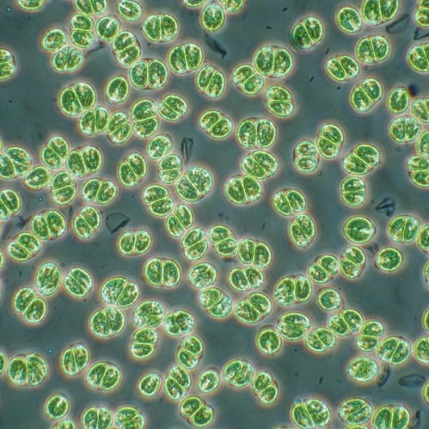
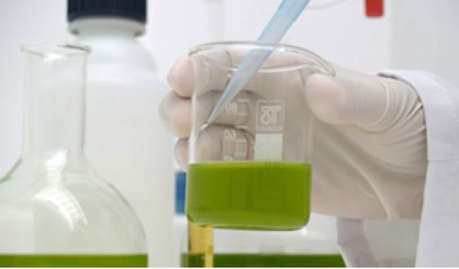
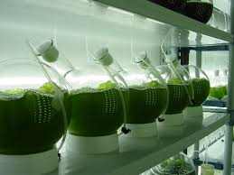
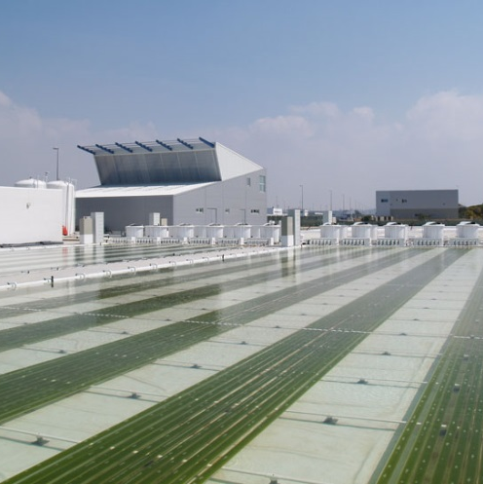


Task 1.3: Microalgae cultivation in liquid foam-beds
WUR- Agnes Janoska, Marcel Janssen
Notes:
The work is performed in the framework of the MIRACLES project which is supported by the European Commission through the 7th Framework Program under Grant Agreement No. 613588.

Slide 2

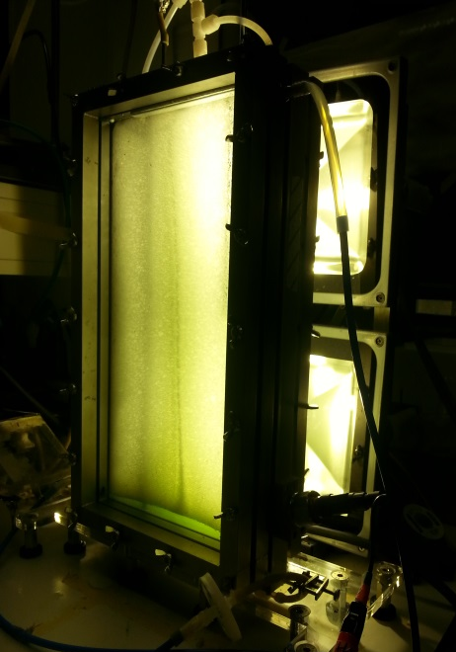
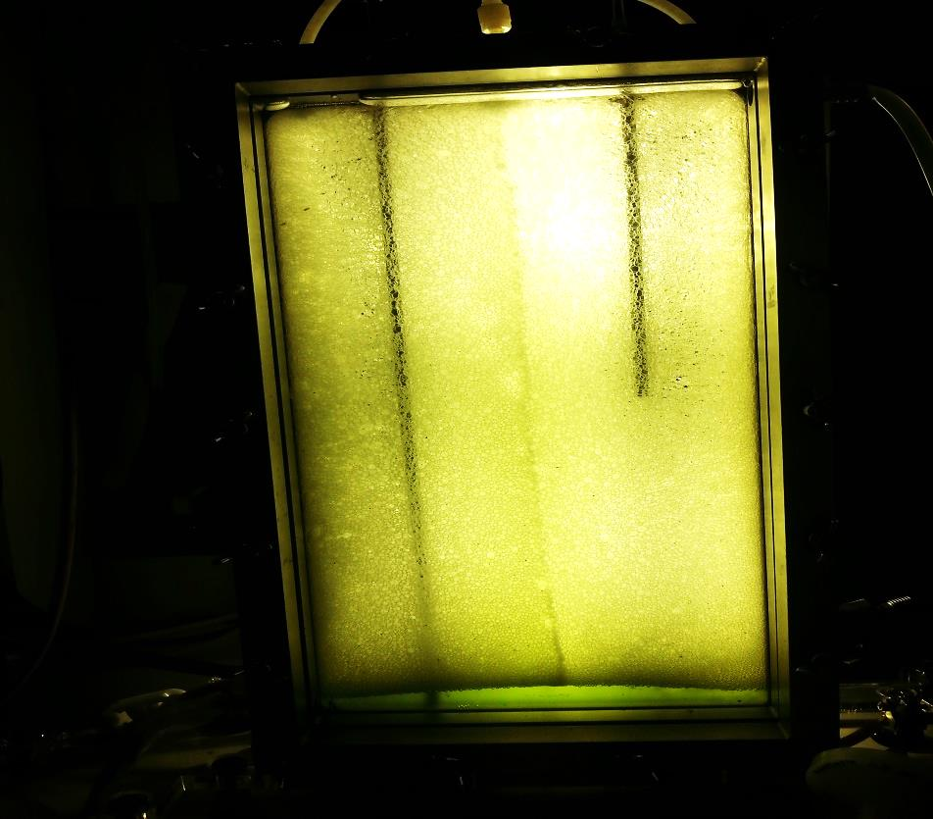
Reminder
Proof of principle reactor runs with BSA
  Problem: short reactor runs
  (biodegradation, denaturation)
2) Screening for new surfactants (together with UHU)
  10 surfactants, 3 algal strains
  4 Criteria: Foaming, Toxicity, Biodegradability, Hold-up
  Pluronic F68
Notes:
Just as a quick reminder
Firstly we developed a novel foam reactor...a foam reactor is a flat panel but operated with l foams instead of l...
(10 surfactants, 3 microalgae species)

Slide 3


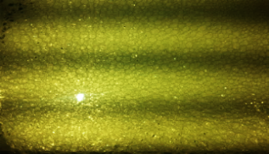
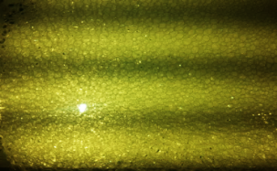


Reminder
3) Growth results in G2 reactor design
+ Proof: growth in PF68 (C. sorokiniana and S. obliquus)
+ PF68 foams for long (weeks)
  - Slow growth: low algae & liquid holdup & gas off
  Non-reproducible growth: biofilm & settling
G1
G2
Incorporated foam breaker
No recirculation
Less surfactant needed
Periodical foam collapse
Notes:
Just as a quick reminder
Firstly we developed a novel foam reactor...a foam reactor is a flat panel but operated with l foams instead of l...
(10 surfactants, 3 microalgae species)

Slide 4
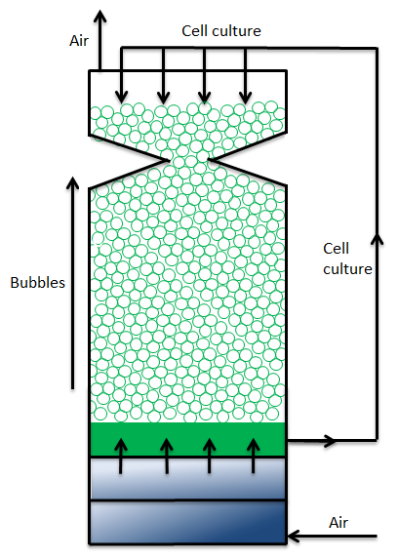
New reactor design!
Low algae holdup ... How to ensure good growth?
New reactor design!
Wet foam
Increased algae conc.
High algae content
in the foam
Notes:
Pluronic F68 –low lgae holdup
How can we still ensure a good growth?
Not only by selecting different surfactant, better modifying the reactor design1
As the model shows us, if we supply liquid on our cultures, our liquid fraction in the foam increases, exposing mmore mocroalgae cells to the foam phase!
Second advantage of this system is that if we recirculate the liquid unde the foam- cotainign increased algae content than the foam,t han we ensure equal liquid distribution between the liquid and the foam phase, elimination the drawback of Pf68 with the reduced algae holdup int he foams.

Slide 5
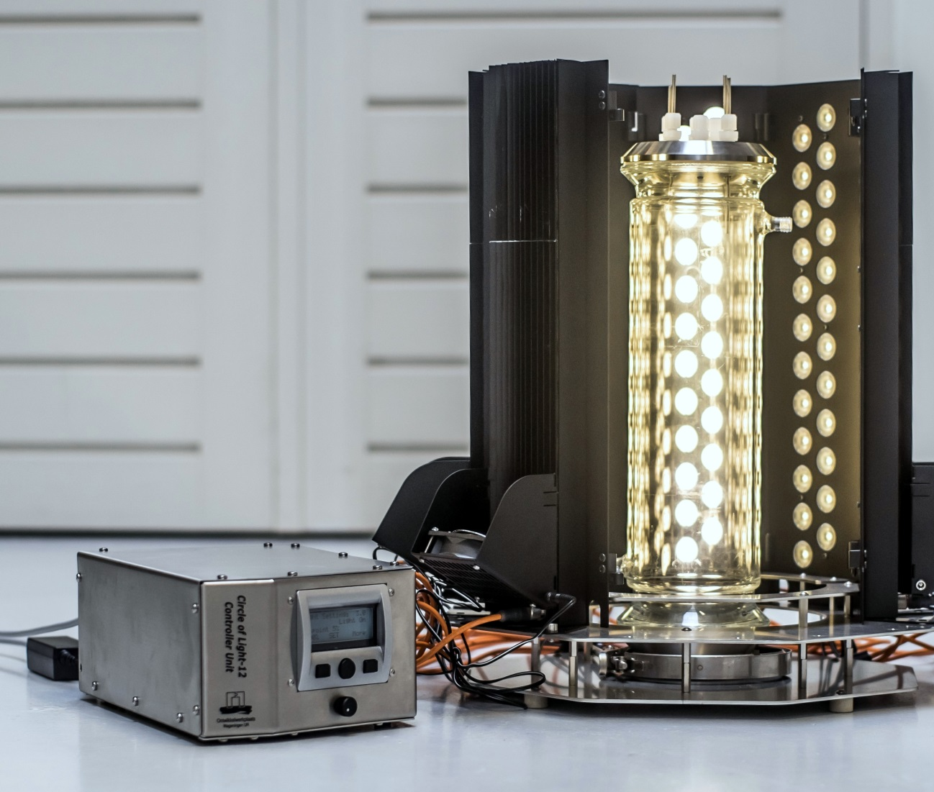
New reactor design
    Cylindrical shape
    Liquid recirculation
No foam breaker
More mixing- hopefully reduces settling and biofilm formation
No need for periodical forced foam collapse

Slide 6
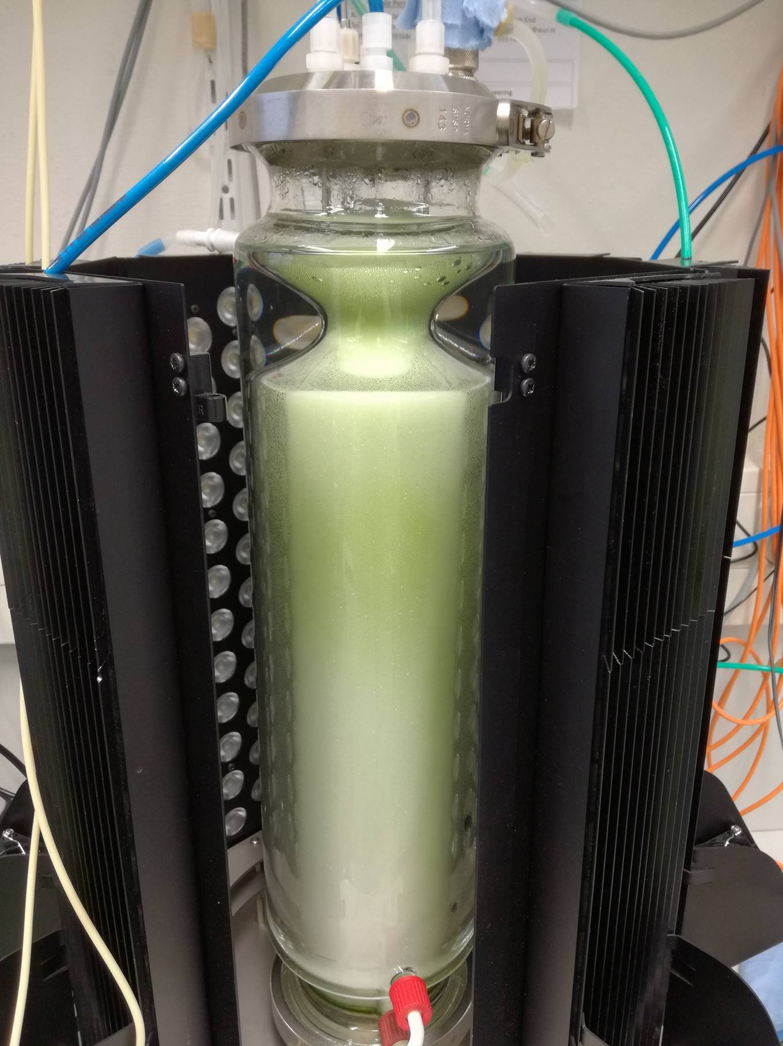
New reactor design
    Preliminary results:
    Operational parameters optimized
    Continuous stable foam formation
    for longer periods
    No need for foam breaker
    Elevated algae& liquid holdup
    First runs with algae ongoing!!
        S. Obliquus showed settling...
        need for light& small cells
Notes:
Pluronic F68 is a suitable foaming agent in the foam-bed reactor. It allows foaming for long time periods (>1week).
Continuous foaming with this surfactant is not possible due to self destabilisation of the foam in time. The foam has to be completely collapsed and re-foamed again from time to time.
Algal growth in Pluronic F68 foams is possible, however, the growth rates are low. This is due to the dry foams formed and the low microalgae holdup in the foam.
To grow microalgae in Pluronic F68 foams, a new reactor design is needed to ensure that a big fraction of the microalgae culture is in the foam. This can be reached by continuously wetting the foam from the top.

Slide 7
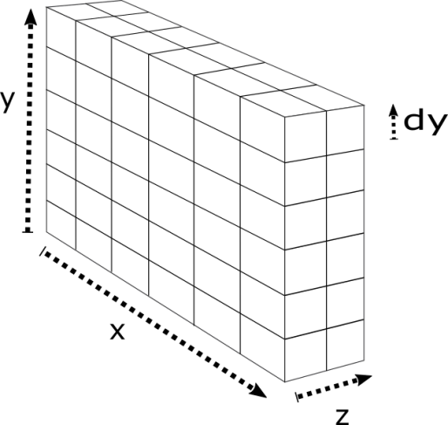
Model development overview
Flat panel photobioreactor with liquid recirculation, continuous operation
Goal: predict reactor productivity under different conditions (reactor dimensions, light, bubble size, gas flow rates, CO2 conc., etc)
1.) Liquid fraction (h)
2.) Light (h,d): diffusion model
3.) Growth (h,d) :light or CO2 dependent
4.) Mass transfer (h): Liquid phase mixed!
Notes:
0.0016 m/s gas flow rate (500 mL/min)
0.4 mm bubble radius

Slide 8
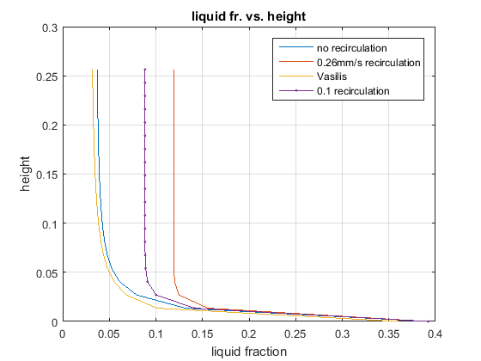
Model development I/III- liquid fraction
Liquid fraction gradient
Recirculation
from ~3% to ~13%
Can increase liquid
content 4 fold!!
Notes:
0.0016 m/s gas flow rate (500 mL/min)
0.4 mm bubble radius

Slide 9
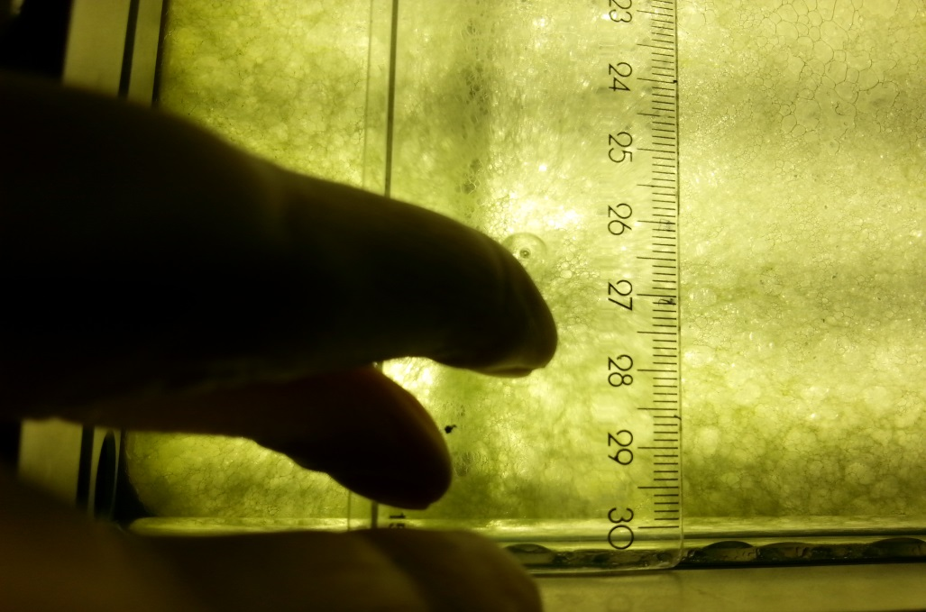
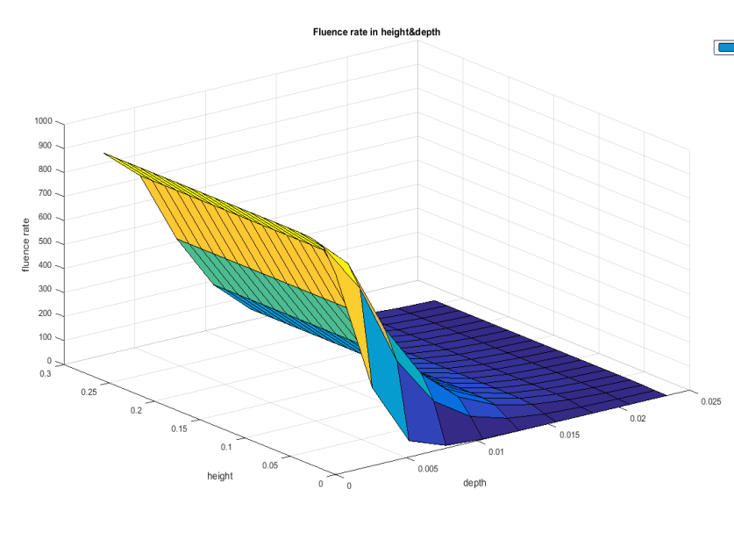
Model development II/III - Light
Scattering
Light diffusion
Jassby & Platt – Fluence rate dependent growth
Fluence rate
No simple Lambert-Beer
Light model
Growth model
Notes:
Kla is the most important parameter describing the mass transfer in liquid foams. The rate of Co2 transfer in the foam can be calculated with the following formula, including Kla, the concentration difference and the volume of the foam bed.
According to our own measurements, we achieved a kla of ... Int he foam reactor and a ... In the same reactor operated as flat panel bubble column.
These results show that this reactor is indeed more efficient in gas transfer compared to other photobioreactors, thereby have the potential to reduce operating costs at lrge scale.
0.18 s-1
Perry, D.C. and P. Stevenson, Gas absorption and reaction in a wet pneumatic foam. Chemical Engineering Science, 2015. 126: p. 177-185.
Other bubble columns 0.0064 s⁻¹ -0.0178 s⁻¹
Poughon, L., et al., k(L)a determination: comparative study for a gas mass balance method. Bioprocess and Biosystems Engineering, 2003. 25(6): p. 341-348.

Slide 10
Model development III/III – Mass transfer
Mass transfer
Ideally mixed liquid phase
Plug flow gas phase
Changes in depth due to light
& in height due to liquid
fraction gradient
-> all averaged for the liquid phase
-> so gas phase only change in height
Notes:
Kla is the most important parameter describing the mass transfer in liquid foams. The rate of Co2 transfer in the foam can be calculated with the following formula, including Kla, the concentration difference and the volume of the foam bed.
According to our own measurements, we achieved a kla of ... Int he foam reactor and a ... In the same reactor operated as flat panel bubble column.
These results show that this reactor is indeed more efficient in gas transfer compared to other photobioreactors, thereby have the potential to reduce operating costs at lrge scale.
0.18 s-1
Perry, D.C. and P. Stevenson, Gas absorption and reaction in a wet pneumatic foam. Chemical Engineering Science, 2015. 126: p. 177-185.
Other bubble columns 0.0064 s⁻¹ -0.0178 s⁻¹
Poughon, L., et al., k(L)a determination: comparative study for a gas mass balance method. Bioprocess and Biosystems Engineering, 2003. 25(6): p. 341-348.

Slide 11
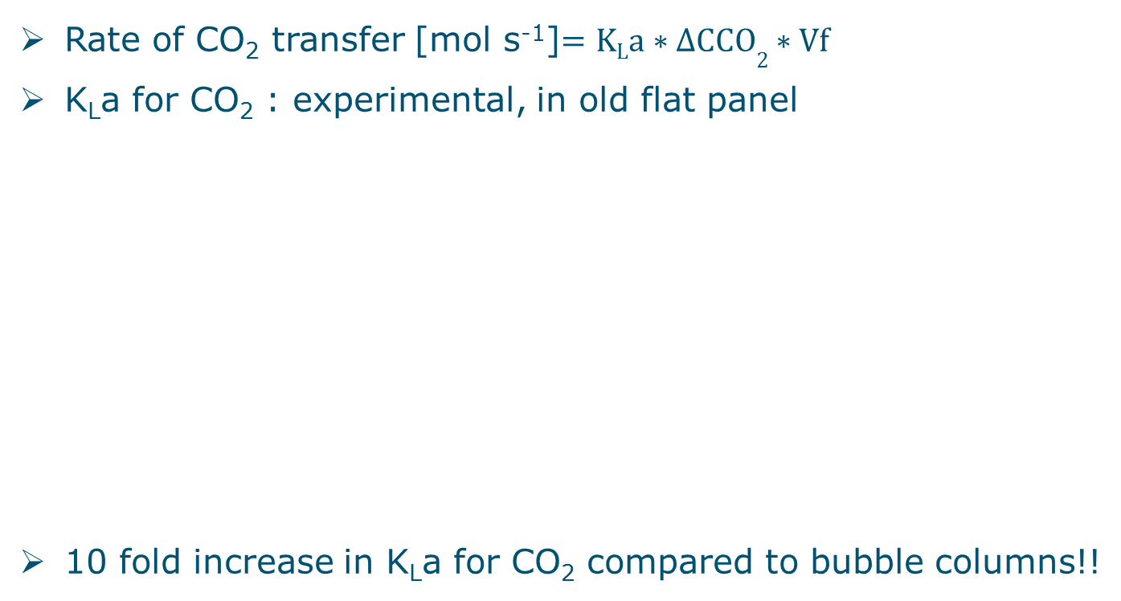
Model development III/III – Mass transfer
Mass transfer
Rate of CO₂ transfer [mol s⁻¹]$=KLa∗∆CCO2∗Vf$
K_{L}a for CO₂ : experimental, in old flat panel
10 fold increase in K_{L}a for CO₂ compared to bubble columns!!
0.0924 s⁻¹ 0.00820 s⁻¹
Notes:
Kla is the most important parameter describing the mass transfer in liquid foams. The rate of Co2 transfer in the foam can be calculated with the following formula, including Kla, the concentration difference and the volume of the foam bed.
According to our own measurements, we achieved a kla of ... Int he foam reactor and a ... In the same reactor operated as flat panel bubble column.
These results show that this reactor is indeed more efficient in gas transfer compared to other photobioreactors, thereby have the potential to reduce operating costs at lrge scale.
0.18 s-1
Perry, D.C. and P. Stevenson, Gas absorption and reaction in a wet pneumatic foam. Chemical Engineering Science, 2015. 126: p. 177-185.
Other bubble columns 0.0064 s⁻¹ -0.0178 s⁻¹
Poughon, L., et al., k(L)a determination: comparative study for a gas mass balance method. Bioprocess and Biosystems Engineering, 2003. 25(6): p. 341-348.

Slide 12
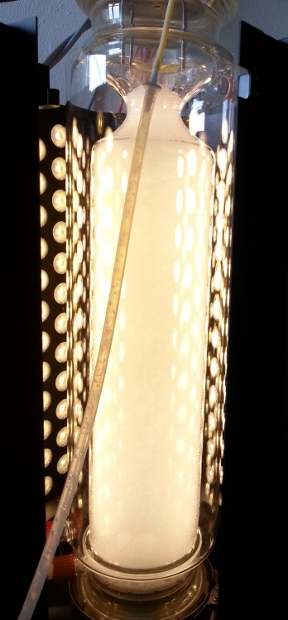
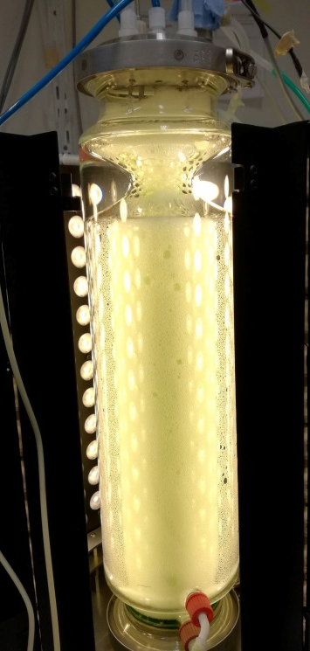
Conclusions & Future work
    Conclusions
    Pluronic F68 is a suitable foaming agent, despite its low algae holdup->
    New reactor design developed, promising preliminary results
      Allowing for high microalgae and liquid content
  Future work
  Finalise modelling of the system
  Inoculate the reactor with different strains
  Operate reactor in continuous mode
Notes:
Cos of the lower foamin capacities, new design was required
To meet the requitements of the foams formed by the new surfactamt
Destabilising effect of microalgae cells on foam stability
Different algae species and concentrations to determine Cx for continuous operation

Slide 13
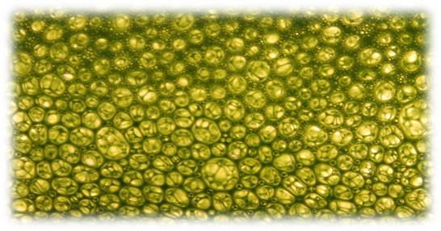
Thanks!

